Slide 1
CPU ARCHITECTURES

Slide 2
Multi-core architectures

Slide 3
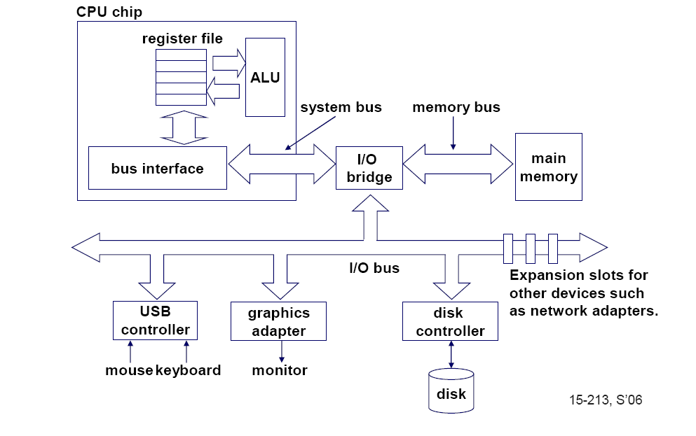
Single-core computer

Slide 4
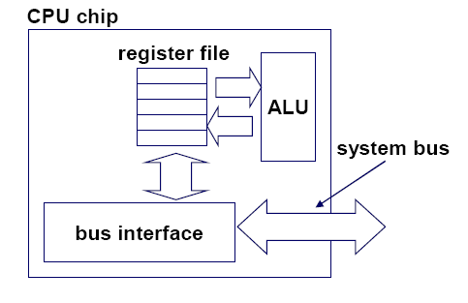
Single-core CPU chip
the single core

Slide 5
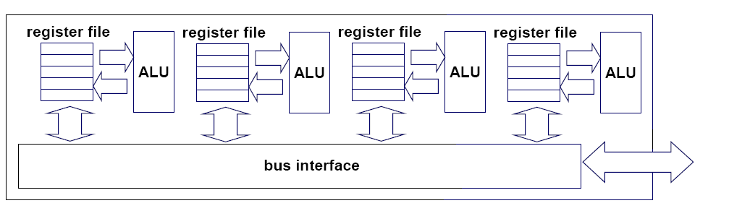
Multi-core architectures
This lecture is about a new trend in computer architecture:
Replicate multiple processor cores on a single die.
Core 1
Core 2
Core 3
Core 4
Multi-core CPU chip

Slide 6
Multi-core CPU chip
The cores fit on a single processor socket
Also called CMP (Chip Multi-Processor)
core
1
core
2
core
3
core
4

Slide 7
The cores run in parallel
thread 1
thread 2
thread 3
thread 4
core
1
core
2
core
3
core
4

Slide 8
Within each core, threads are time-sliced (just like on a uniprocessor)
several
threads
several
threads
several
threads
several
threads
core
1
core
2
core
3
core
4

Slide 9
Interaction with the
Operating System
OS perceives each core as a separate processor
OS scheduler maps threads/processes
to different cores
Most major OS support multi-core today:
Windows, Linux, Mac OS X, …

Slide 10

Why multi-core ?
Difficult to make single-core
clock frequencies even higher
Deeply pipelined circuits:
  heat problems
  speed of light problems
  difficult design and verification
  large design teams necessary
  server farms need expensive
  air-conditioning
Many new applications are multithreaded
General trend in computer architecture (shift towards more parallelism)

Slide 11
Instruction-level parallelism
Parallelism at the machine-instruction level
The processor can re-order, pipeline instructions, split them into microinstructions, do aggressive branch prediction, etc.
Instruction-level parallelism enabled rapid increases in processor speeds over the last 15 years
Notes:
Instruction level parallelism is a measure of how many of the instructions in a computer can be executed simultaneously.

Slide 12
Thread-level parallelism (TLP)
This is parallelism on a more coarser scale
Server can serve each client in a separate thread (Web server, database server)
A computer game can do AI, graphics, and physics in three separate threads
Single-core superscalar processors cannot fully exploit TLP
Multi-core architectures are the next step in processor evolution: explicitly exploiting TLP
Notes:
TLP is a form of technique where multi processors distribute threads across different parallel processor nodes.

Slide 13

General context: Multiprocessors
Multiprocessor is any
computer with several
processors
SIMD
  Single instruction, multiple data
  Modern graphics cards
MIMD
  Multiple instructions, multiple data
Lemieux cluster,
Pittsburgh
supercomputing
center

Slide 14
Multiprocessor memory types
Shared memory:
In this model, there is one (large) common shared memory for all processors
Distributed memory:
In this model, each processor has its own (small) local memory, and its content is not replicated anywhere else

Slide 15
Multi-core processor is a special kind of a multiprocessor:
All processors are on the same chip
Multi-core processors are MIMD:
Different cores execute different threads (Multiple Instructions), operating on different parts of memory (Multiple Data).
Multi-core is a shared memory multiprocessor:
All cores share the same memory

Slide 16


What applications benefit from multi-core?
Database servers
Web servers (Web commerce)
Compilers
Multimedia applications
Scientific applications, CAD/CAM
In general, applications with
Thread-level parallelism
(as opposed to instruction-level parallelism)
Each can run on its
own core

Slide 17
More examples
Editing a photo while recording a TV show through a digital video recorder
Downloading software while running an anti-virus program
“Anything that can be threaded today will map efficiently to multi-core”
BUT: some applications difficult to
parallelize

Slide 18
A technique complementary to multi-core:
Simultaneous multithreading
Problem addressed:
The processor pipeline
can get stalled:
  Waiting for the result
  of a long floating point
  (or integer) operation
  Waiting for data to
  arrive from memory
Other execution units
wait unused
Source: Intel
Notes:
Pipelining attempts to keep every part of the processor busy with some instruction by dividing the incoming instructions in sequential steps

Slide 19
Simultaneous multithreading (SMT)
Permits multiple independent threads to execute SIMULTANEOUSLY on the SAME core
Weaving together multiple “threads”
on the same core
Example: if one thread is waiting for a floating point operation to complete, another thread can use the integer units

Slide 20
Without SMT, only a single thread can run at any given time
L1 D-Cache D-TLB
Integer
Floating Point
Schedulers
L2 Cache and Control
Uop queues
Rename/Alloc
BTB
Trace Cache
uCode ROM
Decoder
Bus
BTB and I-TLB
Thread 1: floating point

Slide 21
Without SMT, only a single thread can run at any given time
L1 D-Cache D-TLB
Integer
Floating Point
Schedulers
L2 Cache and Control
Uop queues
Rename/Alloc
BTB
Trace Cache
uCode ROM
Decoder
Bus
BTB and I-TLB
Thread 2:
integer operation

Slide 22
SMT processor: both threads can run concurrently
L1 D-Cache D-TLB
Integer
Floating Point
Schedulers
L2 Cache and Control
Uop queues
Rename/Alloc
BTB
Trace Cache
uCode ROM
Decoder
Bus
BTB and I-TLB
Thread 2:
integer operation
Thread 1: floating point

Slide 23
But: Can’t simultaneously use the same functional unit
L1 D-Cache D-TLB
Integer
Floating Point
Schedulers
L2 Cache and Control
Uop queues
Rename/Alloc
BTB
Trace Cache
uCode ROM
Decoder
This scenario is
impossible with SMT
on a single core
(assuming a single integer unit)
Bus
BTB and I-TLB
Thread 1
Thread 2
IMPOSSIBLE

Slide 24
SMT not a “true” parallel processor
Enables better threading (e.g. up to 30%)
OS and applications perceive each simultaneous thread as a separate
“virtual processor”
The chip has only a single copy
of each resource
Compare to multi-core:
each core has its own copy of resources

Slide 25
Multi-core: threads can run on separate cores
L1 D-Cache D-TLB
L1 D-Cache D-TLB
Integer
Floating Point
Integer
Floating Point
Schedulers
Schedulers
L2 Cache and Control
Uop queues
L2 Cache and Control
Uop queues
Rename/Alloc
Rename/Alloc
BTB
Trace Cache
uCode
ROM
BTB
Trace Cache
uCode
ROM
Decoder
Decoder
Bus
BTB and I-TLB
Bus
BTB and I-TLB
Thread 1
Thread 2

Slide 26
Multi-core: threads can run on separate cores
L1 D-Cache D-TLB
L1 D-Cache D-TLB
Integer
Floating Point
Integer
Floating Point
Schedulers
Schedulers
L2 Cache and Control
Uop queues
L2 Cache and Control
Uop queues
Rename/Alloc
Rename/Alloc
BTB
Trace Cache
uCode
ROM
BTB
Trace Cache
uCode
ROM
Decoder
Decoder
Bus
BTB and I-TLB
Bus
BTB and I-TLB
Thread 3
Thread 4

Slide 27
Combining Multi-core and SMT
Cores can be SMT-enabled (or not)
The different combinations:
  Single-core, non-SMT: standard uniprocessor
  Single-core, with SMT
  Multi-core, non-SMT
  Multi-core, with SMT: our fish machines
The number of SMT threads:
2, 4, or sometimes 8 simultaneous threads
Intel calls them “hyper-threads”

Slide 28
SMT Dual-core: all four threads can run concurrently
_x001a_
L1 D-Cache D-TLB
L1 D-Cache D-TLB
Integer
Floating Point
Integer
Floating Point
Schedulers
Schedulers
L2 Cache and Control
Uop queues
L2 Cache and Control
Uop queues
Rename/Alloc
Rename/Alloc
BTB
Trace Cache
uCode
ROM
BTB
Trace Cache
uCode
ROM
Decoder
Decoder
Bus
BTB and I-TLB
Bus
BTB and I-TLB
Thread 1
Thread 3
Thread 2
Thread 4

Slide 29
Comparison: multi-core vs SMT
Advantages/disadvantages?

Slide 30
Comparison: multi-core vs SMT
Multi-core:
  Since there are several cores,
  each is smaller and not as powerful
  (but also easier to design and manufacture)
  However, great with thread-level parallelism
SMT
  Can have one large and fast superscalar core
  Great performance on a single thread
  Mostly still only exploits instruction-level parallelism

Slide 31
The memory hierarchy
If simultaneous multithreading only:
  all caches shared
Multi-core chips:
  L1 caches private
  L2 caches private in some architectures
  and shared in others
Memory is always shared

Slide 32
“Fish” machines
hyper-threads
Dual-core
Intel Xeon processors
Each core is
hyper-threaded
Private L1 caches
Shared L2 caches
C O R E 1
C O R E 0
L1 cache
L1 cache
L2 cache
memory

Slide 33
Designs with private L2 caches
C O R E 1
C O R E 0
C O R E 1
C O R E 0
L1 cache
L1 cache
L1 cache
L1 cache
L2 cache
L2 cache
L2 cache
L2 cache
L3 cache
L3 cache
memory
memory
Both L1 and L2 are private
Examples: AMD Opteron,
AMD Athlon, Intel Pentium D
A design with L3 caches
Example: Intel Itanium 2

Slide 34
Private vs shared caches?
Advantages/disadvantages?

Slide 35
Private vs shared caches
Advantages of private:
  They are closer to core, so faster access
  Reduces contention
Advantages of shared:
  Threads on different cores can share the same cache data
  More cache space available if a single (or a few) high-performance thread runs on the system

Slide 36
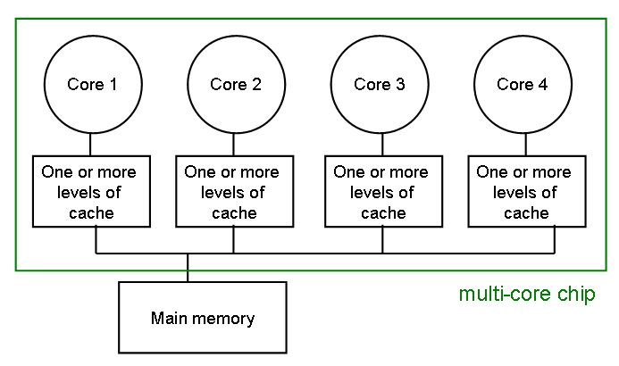
The cache coherence problem
Since we have private caches:
How to keep the data consistent across caches?
Each core should perceive the memory as a monolithic array, shared by all the cores
Notes:
Cache coherence problem: multiple copies of the same data can exist in different caches simultaneously.
Cache coherence refers to the problem of keeping data in these caches consistent.

Slide 37
The cache coherence problem
Suppose variable x initially contains 15213
Core 1
Core 2
Core 3
Core 4
One or more
levels of
cache
One or more
levels of
cache
One or more
levels of
cache
One or more
levels of
cache
multi-core chip
Main memory
x=15213

Slide 38
The cache coherence problem
Core 1 reads x
Core 1
Core 2
Core 3
Core 4
One or more
levels of
cache
x=15213
One or more
levels of
cache
One or more
levels of
cache
One or more
levels of
cache
multi-core chip
Main memory
x=15213

Slide 39
The cache coherence problem
Core 2 reads x
Core 1
Core 2
Core 3
Core 4
One or more
levels of
cache
x=15213
One or more
levels of
cache
x=15213
One or more
levels of
cache
One or more
levels of
cache
multi-core chip
Main memory
x=15213

Slide 40
The cache coherence problem
Core 1 writes to x, setting it to 21660
Core 1
Core 2
Core 3
Core 4
One or more
levels of
cache
x=21660
One or more
levels of
cache
x=15213
One or more
levels of
cache
One or more
levels of
cache
multi-core chip
Main memory
x=21660
assuming
write-through
caches

Slide 41
The cache coherence problem
Core 2 attempts to read x… gets a stale copy
Core 1
Core 2
Core 3
Core 4
One or more
levels of
cache
x=21660
One or more
levels of
cache
x=15213
One or more
levels of
cache
One or more
levels of
cache
multi-core chip
Main memory
x=21660

Slide 42
Solutions for cache coherence
This is a general problem with multiprocessors, not limited just to multi-core
There exist many solution algorithms, coherence protocols, etc.
A simple solution:
invalidation-based protocol with snooping

Slide 43
Inter-core bus
Core 1
Core 2
Core 3
Core 4
One or more
levels of
cache
One or more
levels of
cache
One or more
levels of
cache
One or more
levels of
cache
multi-core chip
Main memory
inter-core
bus

Slide 44
Invalidation protocol with snooping
Invalidation:
If a core writes to a data item, all other copies of this data item in other caches are invalidated
Snooping:
All cores continuously “snoop” (monitor) the bus connecting the cores.

Slide 45
The cache coherence problem
Revisited: Cores 1 and 2 have both read x
Core 1
Core 2
Core 3
Core 4
One or more
levels of
cache
x=15213
One or more
levels of
cache
x=15213
One or more
levels of
cache
One or more
levels of
cache
multi-core chip
Main memory
x=15213

Slide 46
The cache coherence problem
Core 1 writes to x, setting it to 21660
Core 1
Core 2
Core 3
Core 4
One or more
levels of
cache
x=21660
One or more
levels of
cache
x=15213
One or more
levels of
cache
One or more
levels of
cache
sends
invalidation
request
INVALIDATED
multi-core chip
Main memory
x=21660
assuming
write-through
caches
inter-core
bus

Slide 47
The cache coherence problem
After invalidation:
Core 1
Core 2
Core 3
Core 4
One or more
levels of
cache
x=21660
One or more
levels of
cache
One or more
levels of
cache
One or more
levels of
cache
multi-core chip
Main memory
x=21660

Slide 48
The cache coherence problem
Core 2 reads x. Cache misses, and loads the new copy.
Core 1
Core 2
Core 3
Core 4
One or more
levels of
cache
x=21660
One or more
levels of
cache
x=21660
One or more
levels of
cache
One or more
levels of
cache
multi-core chip
Main memory
x=21660

Slide 49
Alternative to invalidate protocol: update protocol
Core 1 writes x=21660:
Core 1
Core 2
Core 3
Core 4
One or more
levels of
cache
x=21660
One or more
levels of
cache
x=21660
One or more
levels of
cache
One or more
levels of
cache
UPDATED
broadcasts
updated
value
multi-core chip
Main memory
x=21660
assuming
write-through
caches
inter-core
bus

Slide 50
Which do you think is better? Invalidation or update?

Slide 51
Invalidation vs update
Multiple writes to the same location
  invalidation: only the first time
  update: must broadcast each write
  (which includes new variable value)
Invalidation generally performs better:
it generates less bus traffic

Slide 52
Invalidation protocols
This was just the basic
invalidation protocol
More sophisticated protocols
use extra cache state bits
MSI, MESI
(Modified, Exclusive, Shared, Invalid)

Slide 53
Programming for multi-core
Programmers must use threads or processes
Spread the workload across multiple cores
Write parallel algorithms
OS will map threads/processes to cores

Slide 54
Thread safety very important
Pre-emptive context switching:
context switch can happen AT ANY TIME
True concurrency, not just uniprocessor time-slicing
Concurrency bugs exposed much faster with multi-core

Slide 55
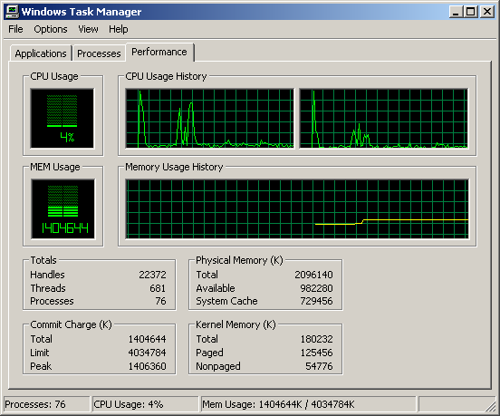
Windows Task Manager
core 2
core 1

Slide 56
Legal licensing issues
Will software vendors charge a separate license per each core or only a single license per chip?
Microsoft, Red Hat Linux, Suse Linux will license their OS per chip, not per core

Slide 57

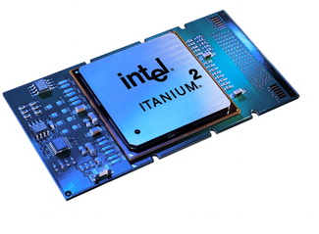
Conclusion
Multi-core chips an
important new trend in
computer architecture
Several new multi-core
chips in design phases
Parallel programming techniques likely to gain importance

